Slide 1



Creating Collaborative Capacity with School Wellness Champions and Supporters David Lounsbury, PhD Asst. Professor, Epidemiology & Population Health Albert Einstein College of Medicine Bronx, NY 2017 Coordinator Winter Training Chickasaw Retreat and Conference Center Sulphur, OK  2 Feb 2017
www.healthcorps.org
Notes:
I am a community psychologist with expertise in public health research and systems thinking
I am part of the research team for this study

Slide 2


NIH Project Overview
In partnership with HealthCorps and FamilyCook Productions, our 4-year NIH-funded study aims to:
Support healthy choices and behaviors (diet, exercise, mental resilience) via skill-building wellness programming for students
Build collaborative capacity among stakeholders to foster sustainability of school-level wellness
Use systems thinking to guide planning, implementation, and evaluation of both student-level and school-level wellness programming
www.healthcorps.org

Slide 3
What are the USDA Dietary Guidelines?
5 Key Health Behaviors:
Increasing frequency of breakfast
Increasing vegetable and fruit intake (2½ cups/day)
Decreasing sugary beverage intake | Increasing water consumption
Decreasing frequency of fast food meals
Becoming physically active (1 hour/ day) | Reducing sedentary behavior time (<2 hour/day)
www.healthcorps.org

Slide 4
Who are School Wellness Stakeholders, Champions and Supporters?
Stakeholders would be anyone who uses or produces one or more components of school wellness, such as PE, health education, physical activity, school nutrition, staff wellness, mental health, etc.
School stakeholders may include students, teachers, school nurses, administrators, school food staff, custodians, mental health providers, and parents
Champions are stakeholders who are actively engaged in wellness programming your school
Supporters are stakeholders who approve of or like wellness programming, but for many reasons cannot be or do not want to be actively engaged in wellness programming
www.healthcorps.org

Slide 5
What is ‘Systems Thinking’?
A method to help understand how a set of elements or parts function together to achieve a goal
Often, systems do not work as intended
Systems thinking can help us model problems as well as find solutions.
Schools are dynamically complex systems subject to many challenges and, yet, abundant potential:
A school is a system of systems: PA, food service, academic curricula, varsity sports programs, after-school clubs, school security, and student peer groups/cliques
Key question: How to leverage these systems to maximize educational outcomes?

Slide 6
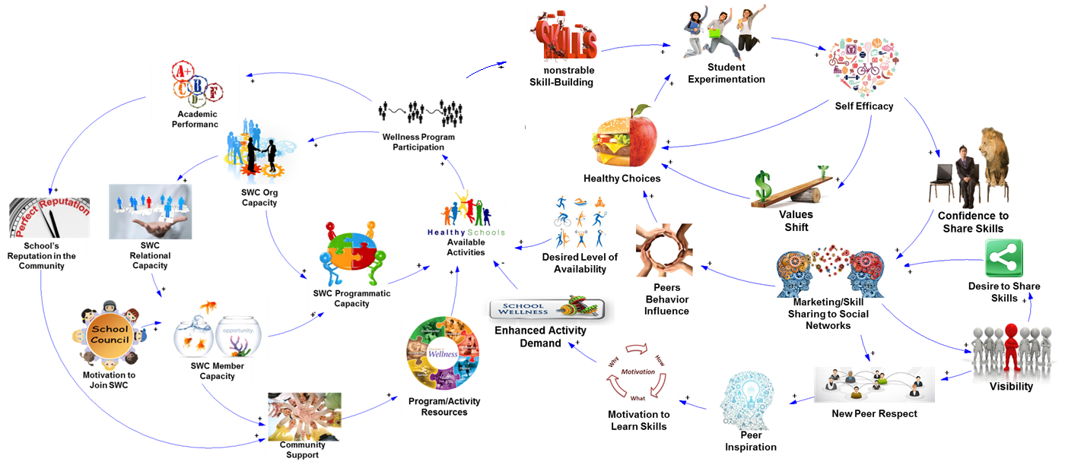
Systems Thinking: Student- and School-Level Loops
FamilyCookProductions.com
School Level
School Level
Demonstrable
Skill-building
Student Level
Student Level
Foster-Fishman et al. (2001)
Notes:
In the Better Wellness for Life introduction, we showed how systems thinking helps us understand how to make positive changes at two levels, at the level of the school and among individual students. Both are important, and, as we can see, progress at either level is interdependent. When your school launches a new, skill-based wellness activity for students, that cycles back to support development and encourage participation in your School Wellness Council. So, let’s focus on making positive change at the school level.

Slide 7



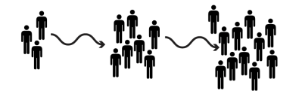










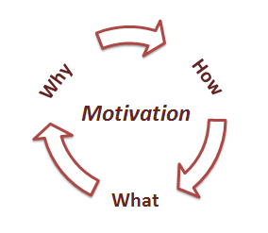


Demonstrable Skill-Building
Self Efficacy
Participation in Activities
Healthy Choices
Values Shift
Available Activities
Desired Level of Availability
Peers Behavior Influence
Desire to Share Skills
Marketing/Skill Sharing to Social Networks
Enhanced Activity Demand
Visibility
Motivation to
Learn Skills
New Peer Respect
Peer Inspiration
Student Level

Slide 8

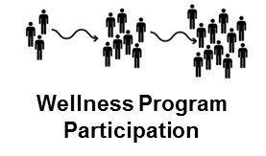





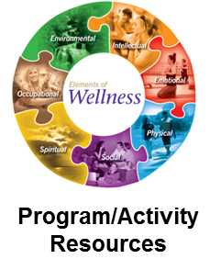

School Level
SWC Org Capacity
School’s Reputation in the Community
SWC Relational Capacity
Available Activities
+
SWC Programmatic Capacity
+
Collaborative Capacity:
Four critical elements
SWC Member Capacity
Notes:
Collaborative capacity is defined by four critical components, or sources, namely relational capacity, member capacity, organizational capacity and programmatic capacity. Each of these is essential to creating collaborative capacity. And each is dynamically related to the other, so as one component grows and develops, so to with the others, and visa versa. And, over time, as shown here, collaborative capacity will have direct impact on making more activities that foster wellness in students available. It will also help build community support for wellness, which means your school will likely find new resources to help make wellness activities more available in your school.

Slide 9
Collaborative Capacity
Foster-Fishman et al. (2001)
Relational capacity: Trust, respect, and strong rapport among wellness champions
Member capacity: Skills and knowledge that help wellness champions work together
Organizational capacity: Ability to support, design, and carry out SMART action plans
Programmatic capacity: Implementing and sustaining a new wellness programs or policies that foster student skill-building

Slide 10
What does Creating Collaborative Capacity have to do with School Wellness?
Capacity: The resources and conditions required to do, experience, or understand something
Collaboration: Working together towards a shared goal
Collaborative capacity: The resources and conditions needed to work together to achieve a shared goal
Creating collaborative capacity will help you and other wellness champions leverage opportunities, priorities, and preferences that promote health behavior change among students and staff

Slide 11

Relational capacity: Trust, respect, and strong rapport among wellness champions and supporters
SWC Relational Capacity
Foster positive internal relationships among wellness champions: Do members know and like each other?
Value member diversity: Give all members voice.
Build external relationships: Parents, DOE Office of School Wellness; local libraries, places of worship, etc.
Notes:
Relational capacity is about trust, respect and about building strong rapport among your wellness champions.
It’s about building positive internal relationships. As a facilitator for your SWC, try to create reasonable, group norms about participation, member involvement, meeting behavior, and that celebrates individual and group successes.
It’s also about valuing member diversity: Where ever possible, try encourage SWC members to voice unique concerns, and then try to translate these concerns into novel, exciting new ideas for wellness activities in your school.
Building external relationships is also important to create relational capacity. Are there organizations or agencies in the community that could be represented on your SWC? Consider results of your HC Community Assessment exercise. Consider reaching out to the Alliance, or the DOE Office of School Wellness.
Ultimately, relational capacity is about co-learning, shared decision-making, and mutual ownership of the processes and the products of the project.

Slide 12
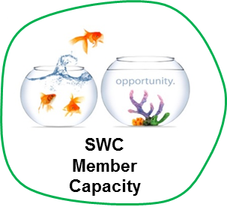
Member capacity: Skills and knowledge that help wellness champions work together
Foster belief in self, others and in the notion of ‘collaboration’ for school wellness
Allow open discussion about wellness challenges and about ways to address them
Turn challenges into novel, exciting new wellness activities
Notes:
Member capacity comes from skills and knowledge that help people work well with each other. It’s really about developing communication skills. In short, it’s about fostering belief in self, others and in the notion of ‘collaboration’ for school wellness.
Allow open discussion about wellness challenges and about ways to address them.

Slide 13


Organizational capacity: Ability and resources to plan, implement and evaluate wellness programs, activities or initiatives
Consider ways work with school systems and resources, like food service, gym, library, student clubs (art, debate, sports)
Students may be your best allies: Build a strong student leadership team
Keep all SWCs abreast of meeting and activities
Notes:
Organizational capacity is really just your SWC’s ability to support, design, and carry out SMART action plans.
Consider ways work with school systems and resources, like food service, gym, library, student clubs (art, debate, sports).
Keep in mind that students may be your strongest allies: Build and sustain a student leadership team, which may be as few as one or two students, but ideally is group of about 5 or 6. They will appreciate the opportunity to take on this role, and you will have a great resource for idea-generating, for mounting activities, and for collecting information to help evaluate your successes and find way to expand activities, down the road.
Make sure to find ways to keep all SWC members abreast of meeting and activities. Social media and school websites may be particularly useful ways to get the work out.

Slide 14


Programmatic capacity: Implementing wellness programs. HC curricula, Café-O-Yeas, local wellness policy initiatives.
Engage stakeholders in discussion about what kind of wellness programming would be most beneficial, useful, welcomed at your school
Use evaluation and feedback tools and processes: SnapShot Reports
Implement skill-based activities that are consistent with Dietary Guidelines
Notes:
Programmatic capacity is getting to the fun stuff: Actually carrying out your wellness activities in school, with your SMART goal as a plan for carrying it out well. Review the information we have provided on various SHARE ACTIVITIES, namely fitness share, MOSO, and Yoga Share.
Knowing what worked and what didn’t is part of best practice. We have provided a number of evaluation tools and measures that you can use to document success and learn how to continually improve the wellness activity in your unique school setting.
Again, implementing skill-based activities will maximize your opportunity to promote key health behavior changes among students.

Slide 15




How to start building collaborative capacity?
SWC Org Capacity
SWC Relational Capacity
SWC Programmatic Capacity
Think relational capacity!
Engage just one other person
you would like to work with,
and start together, right there, right then.
And then watch your school’s collaborative capacity start to grow!
SWC Member Capacity

Slide 16
What to do when collaboration slows or even stops?
SWC Org Capacity
SWC Relational Capacity
SWC Programmatic Capacity
Lots of things will work against your SWC’s efforts.
For example, lack of time, energy, cuts in resources, or progress that’s just too slow.
SWC Member Capacity
When that happens, return to the loops!
Notes:
Collaborating is not easy. Lots of things will work against your SWC’s efforts: Lack of time, energy, resources or just too slow progress
What should you do when collaboration slows or even stops? When that happens, apply your systems thinking!

Slide 17
Healthy-Me Snapshot Survey
A brief, self-report survey administered to students in HC high schools
Used as part of a classroom activity to provide students with feedback messages that will help students set SMART Goals and initiate behavior change related to the USDA Dietary Guidelines and mental resilience.
Target population: All students, male and female, aged 13-21 who are exposed to the HealthCorps core curriculum.
Sample size: Approximately 100 to 200 students per school
Aggregate (school-level) reports can be used to guide selection of Café-O-Yeas and other school-wide wellness programming initiatives

Slide 18
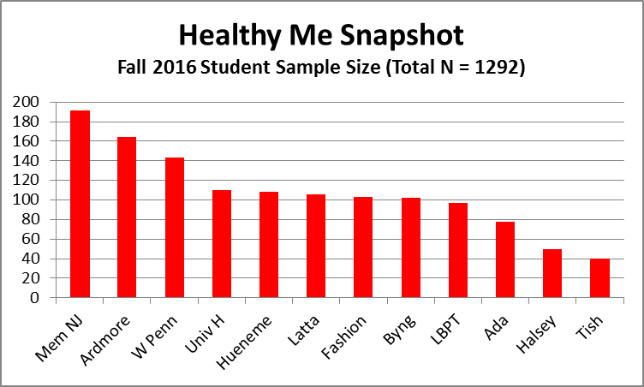
Healthy-Me Snapshot Survey Data Collection (Fall 2016)

Slide 19
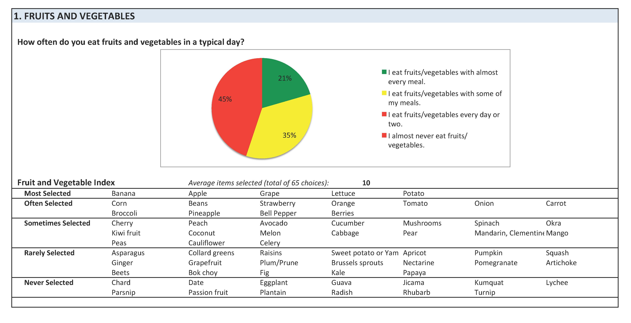
Sample

Slide 20
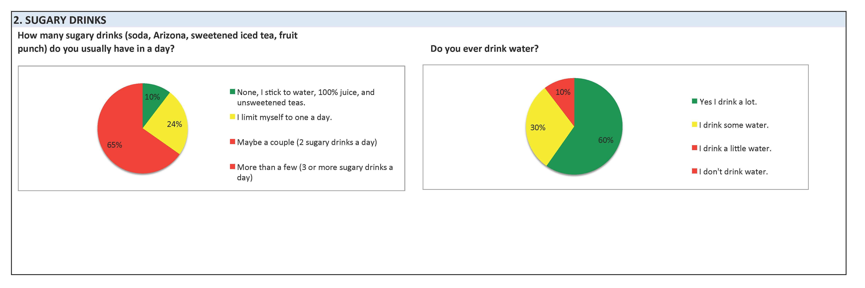
Sample

Slide 21
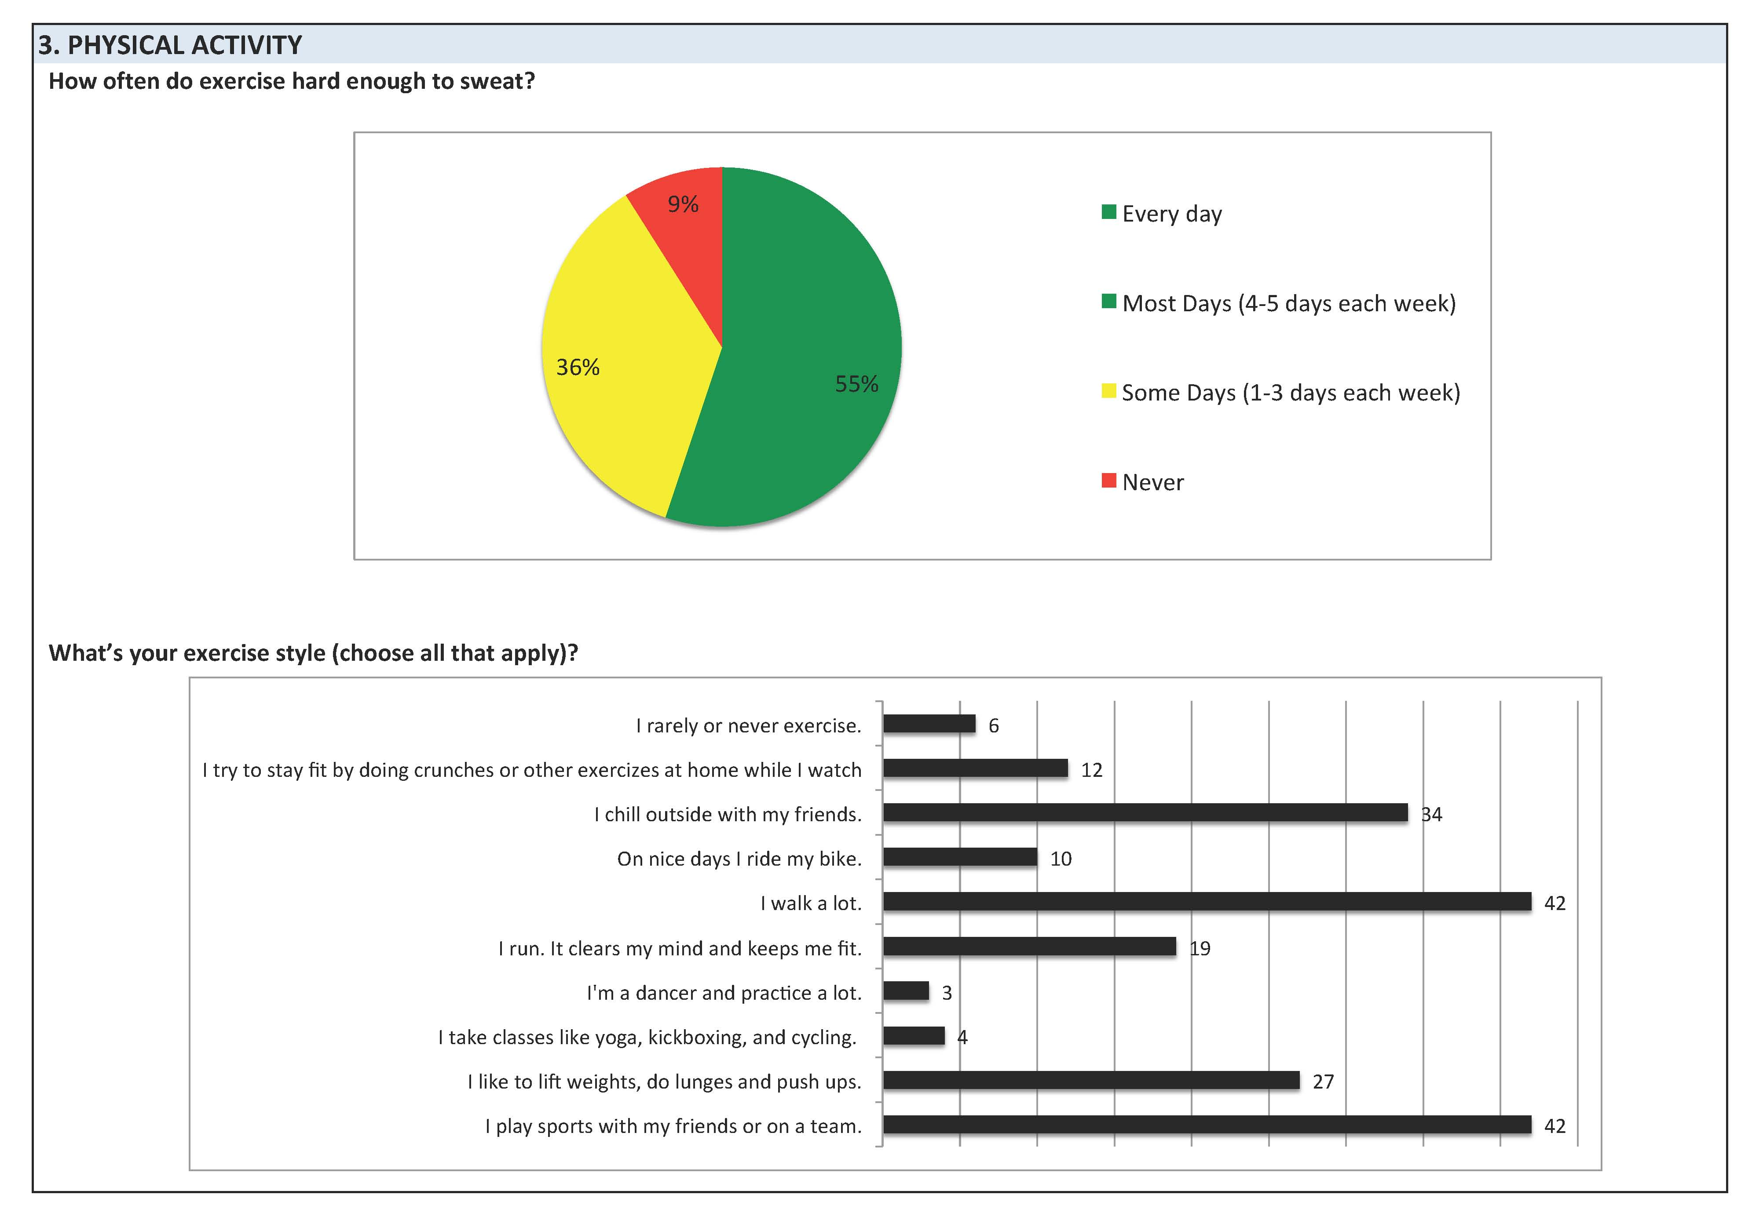
Sample

Slide 22
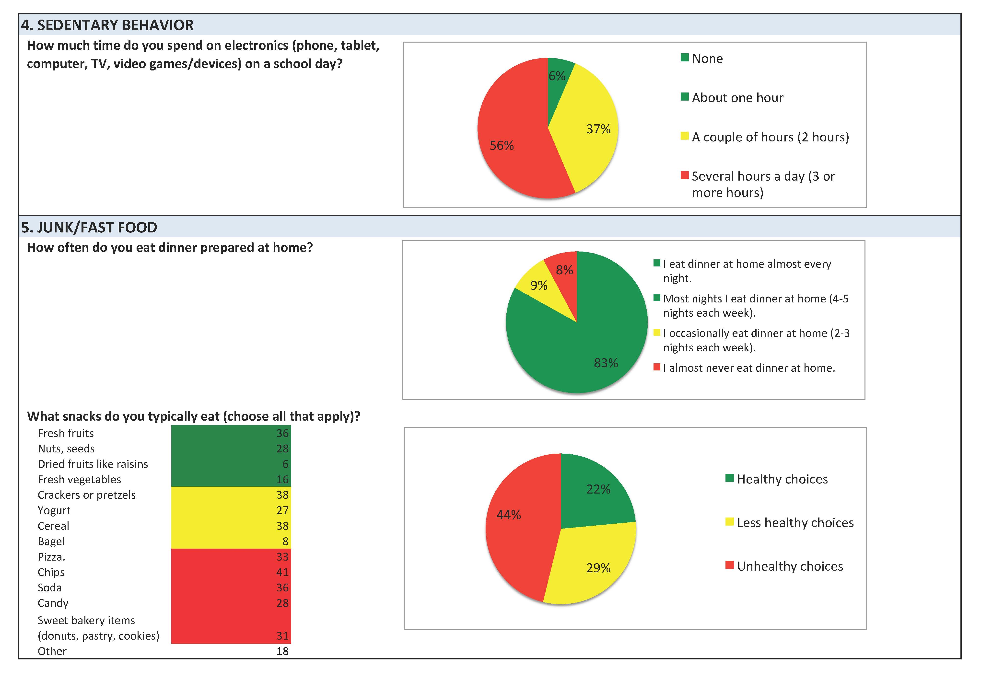
Sample

Slide 23
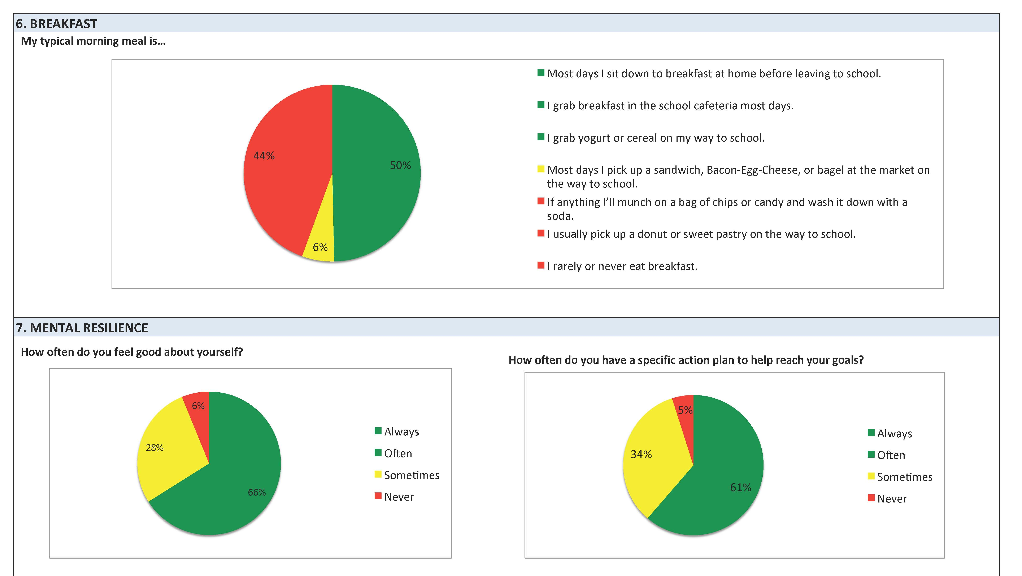
Sample

Slide 24
Healthy School Snapshot: Reflection Questions
How do you think you would you use this tool at your school?
What HC curriculum program components could aggregated results inform?
www.healthcorps.org

Slide 25
Assessing Collaborative Capacity: Two-Part Survey
‘Coordinator’s List’ [https://www.surveymonkey.com/r/COORDINATORretreat]
Identifies an ‘egocentric’ network of school wellness champions and supporters
Completed by HC Coordinators via RedCap electronic survey by end of March 2017
‘School Wellness Champion Survey’ [https://www.surveymonkey.com/r/WCretreat]
Voluntary participation documented by special informed consent
Documents participant’s role/position at school, level of engagement in wellness programming, awareness of local wellness policy implementation, and endorsement of statements about the quality collaboration for wellness programming at the school
Administered via RedCap electronic survey in April/May 2017

Slide 26
Collaborative Capacity Assessment: Reflection Questions
Currently, who are your ‘wellness champions’? Your ‘supporters’? Approximately how many people would you invite to take the survey at your school?
In your opinion, what might turn ‘supporters’ to ‘champions’? Explain.
What would be a useful CC Assessment ‘feedback’ report format? How might such a report be used to foster wellness programming sustainability?
www.healthcorps.org

Slide 27

Thank You!
David Lounsbury, PhD
David.Lounsbury@einstein.yu.edu
Notes:
Thank you for listening. We wish you great success with your SWC. If you want more information or more assistance, just reach out.

